Slide 1
Number System
Farhan Ahmed

Slide 2
Number System
Binary
Octal
Decimal
Hexa-Decimal
( ) 2
( ) 8
( ) 10
( ) 16

Slide 3
( ) 2
( ) 8
( ) 10
( ) 16
Binary
Octal
Decimal
Hexa-Decimal
0 | 0 | 0 | 0
1 | 1 | 1 | 1
 | 2 | 2 | 2
 | 3 | 3 | 3
 | 4 | 4 | 4
 | 5 | 5 | 5
 | 6 | 6 | 6
 | 7 | 7 | 7
 |  | 8 | 8
 |  | 9 | 9
 |  |  | A
 |  |  | B
 |  |  | C
 |  |  | D
 |  |  | E
 |  |  | F

Slide 4
Conversion
( ) 2 ( ) 8 Binary into Octal
( ) 10 ( ) 16 Decimal to Hexa-Decimal

Slide 5
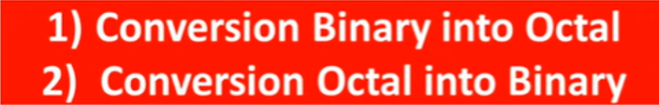

Conversion
( ) 2
( ) 8
Q.) What should be the power of 2 to get 8
Ans.) 2 3 = 8

Slide 6
( ) 2
( ) 8
Q.) What should be the power of 2 to get 8
Ans.) 2 3 = 8

Slide 7
Q.) What should be the power of 2 to get 8
Ans.) 2 3 = 8
0 | 0 | 0
0 | 0 | 1
0 | 1 | 0
0 | 1 | 1
1 | 0 | 0
1 | 0 | 1
1 | 1 | 0
1 | 1 | 1
8/2 = 4
4/2 = 2
2/2 = 1

Slide 8
Q. ) Convert (761 )8 = ( ) 2
0
1
2
3
4
5
6
7
0 | 0 | 0
0 | 0 | 1
0 | 1 | 0
0 | 1 | 1
1 | 0 | 0
1 | 0 | 1
1 | 1 | 0
1 | 1 | 1
111 110 001

Slide 9
Q. ) Convert (71.3 )8 = ( ) 2
0
1
2
3
4
5
6
7
0 | 0 | 0
0 | 0 | 1
0 | 1 | 0
0 | 1 | 1
1 | 0 | 0
1 | 0 | 1
1 | 1 | 0
1 | 1 | 1
111 001 .011

Slide 10
Q. ) Convert (10011 )2 = ( ) 8
0
1
2
3
4
5
6
7
0 | 0 | 0
0 | 0 | 1
0 | 1 | 0
0 | 1 | 1
1 | 0 | 0
1 | 0 | 1
1 | 1 | 0
1 | 1 | 1
0 10 011
2 3

Slide 11
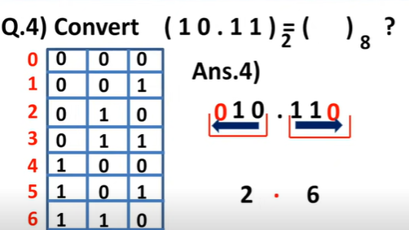
Q. ) Convert (10.11 )2 = ( ) 8
0
1
2
3
4
5
6
7
0 | 0 | 0
0 | 0 | 1
0 | 1 | 0
0 | 1 | 1
1 | 0 | 0
1 | 0 | 1
1 | 1 | 0
1 | 1 | 1
10 . 11
010 . 110
2 . 6

Slide 12
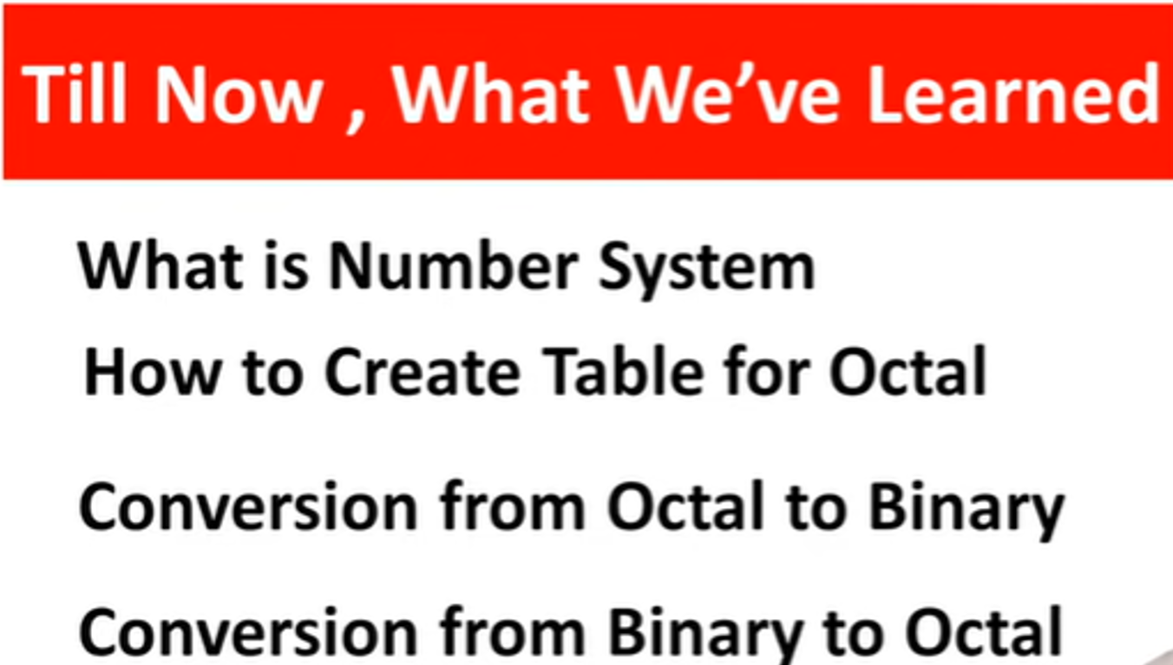

Slide 13
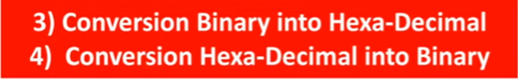
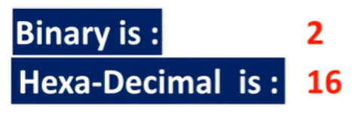
Q.) What should be the power of 2 to get 16
Ans.) 2 4 = 16
Make the table with 4 columns and 16 rows

Slide 14
0
1
2
3
4
5
6
7
8
9
A
B
C
D
E
F
0 | 0 | 0 | 0
0 | 0 | 0 | 1
0 | 0 | 1 | 0
0 | 0 | 1 | 1
0 | 1 | 0 | 0
0 | 1 | 0 | 1
0 | 1 | 1 | 0
0 | 1 | 1 | 1
1 | 0 | 0 | 0
1 | 0 | 0 | 1
1 | 0 | 1 | 0
1 | 0 | 1 | 1
1 | 1 | 0 | 0
1 | 1 | 0 | 1
1 | 1 | 1 | 0
1 | 1 | 1 | 1
Q.) What should be the power of 2 to get 16
Ans.) 2 4 = 16
Make the table with 4 columns and 16 rows
16/2 = 8
8/2 = 4
4/2 = 2

Slide 15
0
1
2
3
4
5
6
7
8
9
A
B
C
D
E
F
0 | 0 | 0 | 0
0 | 0 | 0 | 1
0 | 0 | 1 | 0
0 | 0 | 1 | 1
0 | 1 | 0 | 0
0 | 1 | 0 | 1
0 | 1 | 1 | 0
0 | 1 | 1 | 1
1 | 0 | 0 | 0
1 | 0 | 0 | 1
1 | 0 | 1 | 0
1 | 0 | 1 | 1
1 | 1 | 0 | 0
1 | 1 | 0 | 1
1 | 1 | 1 | 0
1 | 1 | 1 | 1
Q.) Convert (61 ) 16 = ( ) 2
0110 0001

Slide 16
0
1
2
3
4
5
6
7
8
9
A
B
C
D
E
F
0 | 0 | 0 | 0
0 | 0 | 0 | 1
0 | 0 | 1 | 0
0 | 0 | 1 | 1
0 | 1 | 0 | 0
0 | 1 | 0 | 1
0 | 1 | 1 | 0
0 | 1 | 1 | 1
1 | 0 | 0 | 0
1 | 0 | 0 | 1
1 | 0 | 1 | 0
1 | 0 | 1 | 1
1 | 1 | 0 | 0
1 | 1 | 0 | 1
1 | 1 | 1 | 0
1 | 1 | 1 | 1
Q.) Convert (101101 ) 2 = ( ) 16
0010 1101
2 D

Slide 17
0
1
2
3
4
5
6
7
8
9
A
B
C
D
E
F
0 | 0 | 0 | 0
0 | 0 | 0 | 1
0 | 0 | 1 | 0
0 | 0 | 1 | 1
0 | 1 | 0 | 0
0 | 1 | 0 | 1
0 | 1 | 1 | 0
0 | 1 | 1 | 1
1 | 0 | 0 | 0
1 | 0 | 0 | 1
1 | 0 | 1 | 0
1 | 0 | 1 | 1
1 | 1 | 0 | 0
1 | 1 | 0 | 1
1 | 1 | 1 | 0
1 | 1 | 1 | 1
Q.) Convert (101101 ) 2 = ( ) 16
0010 1101
2 D

Slide 18
0
1
2
3
4
5
6
7
8
9
A
B
C
D
E
F
0 | 0 | 0 | 0
0 | 0 | 0 | 1
0 | 0 | 1 | 0
0 | 0 | 1 | 1
0 | 1 | 0 | 0
0 | 1 | 0 | 1
0 | 1 | 1 | 0
0 | 1 | 1 | 1
1 | 0 | 0 | 0
1 | 0 | 0 | 1
1 | 0 | 1 | 0
1 | 0 | 1 | 1
1 | 1 | 0 | 0
1 | 1 | 0 | 1
1 | 1 | 1 | 0
1 | 1 | 1 | 1
Q.) Convert (11.110 ) 2 = ( ) 16
0011 . 1100
3. C

